Slide 1
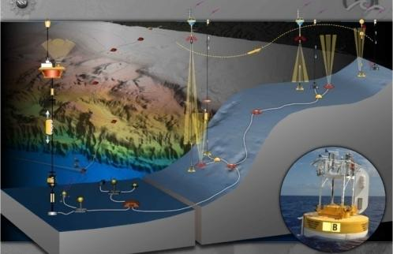
CI Models, Challenges, Best Practices
Ivan Rodero
Associate Research Professor
Associate Director for Technical Operations
Rutgers Discovery Informatics Institute

Slide 2
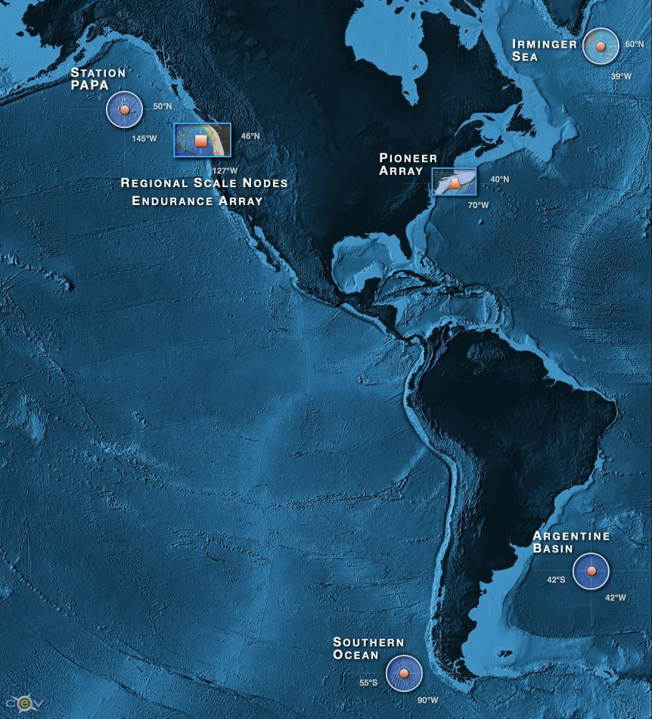
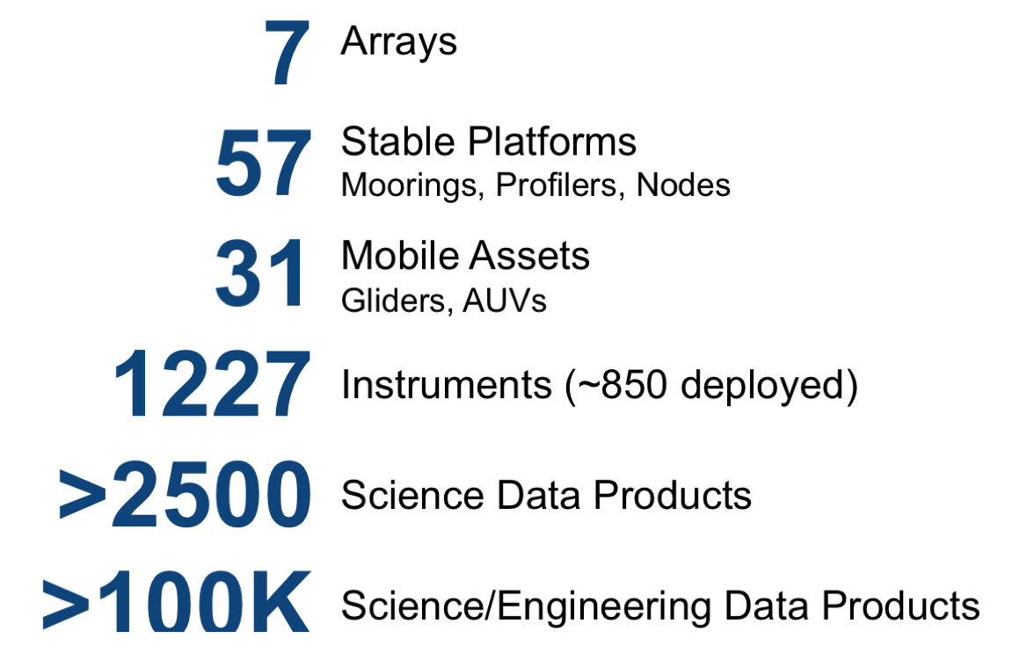
Select critical locations, of high science impact yet data sparse due to challenging nature
Deploy cutting edge platforms
Equip with multidisciplinary sensors
Provide as much real time data as possible
Provide as much interactive capability as possible
Provide additional bandwidth and carrying capacity
Launch crucial long-term measurements that resolve high frequencies and episodic events
Make all data available
ooinet.oceanobservatories.org

Slide 3
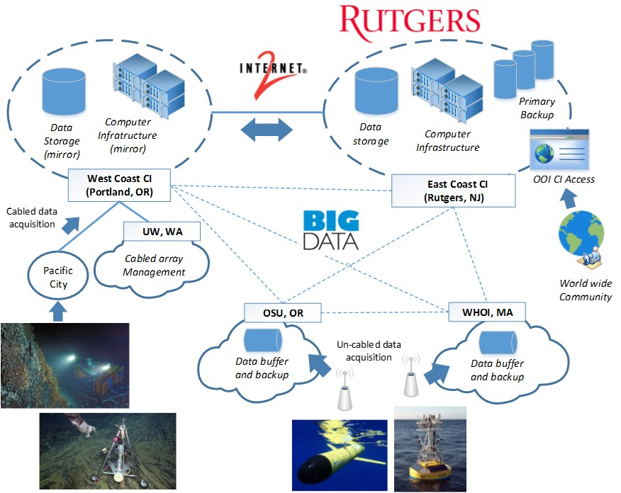
OOI CI Overall Architecture
Overall Capacity:
~25PB storage
130+ servers (dual Xeon)
100G network backbone
Palo Alto Firewalls
Notes:
Robust, secure, and scalable production CI
State-of-the-art architecture based on CI best practices
Enterprise storage architecture
Flexible, highly-available network
24/7 delivery of data & services
Redundant data delivery paths
Integrated cyber-security
Federated identity management
Comprehensive monitoring and analytics

Slide 4
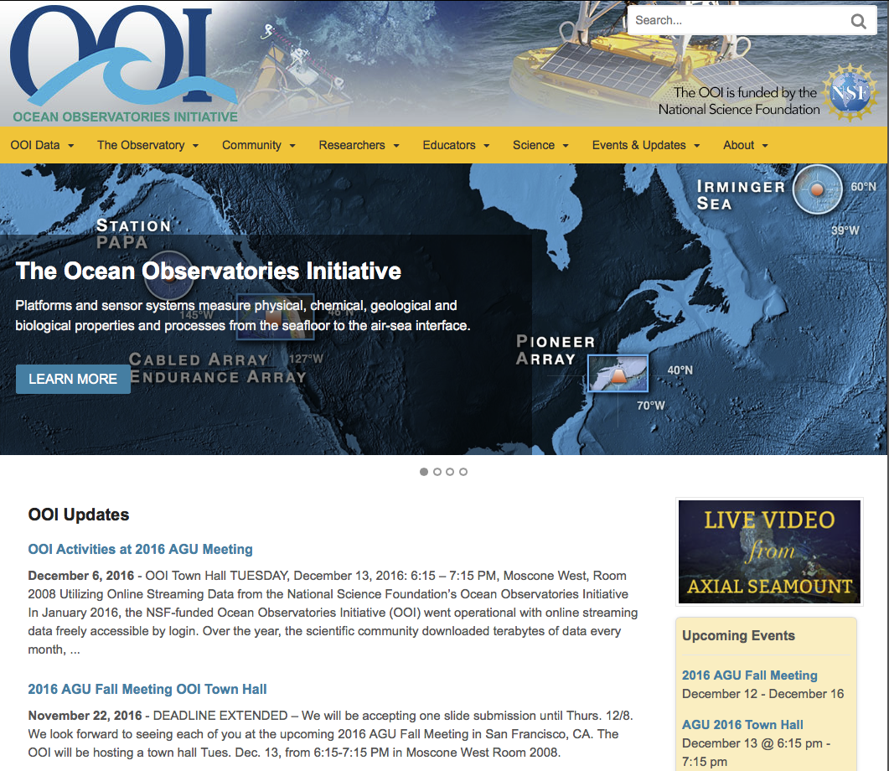
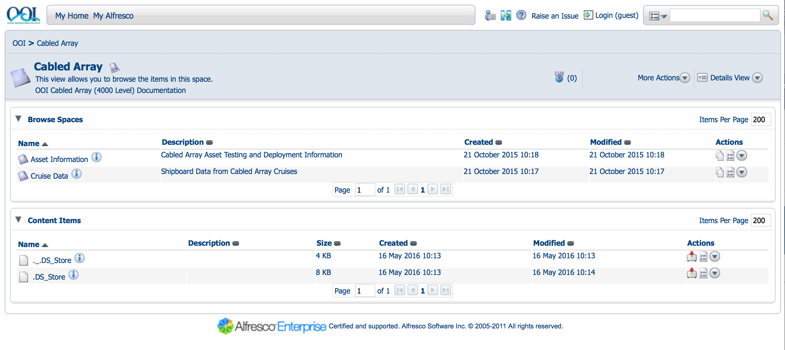
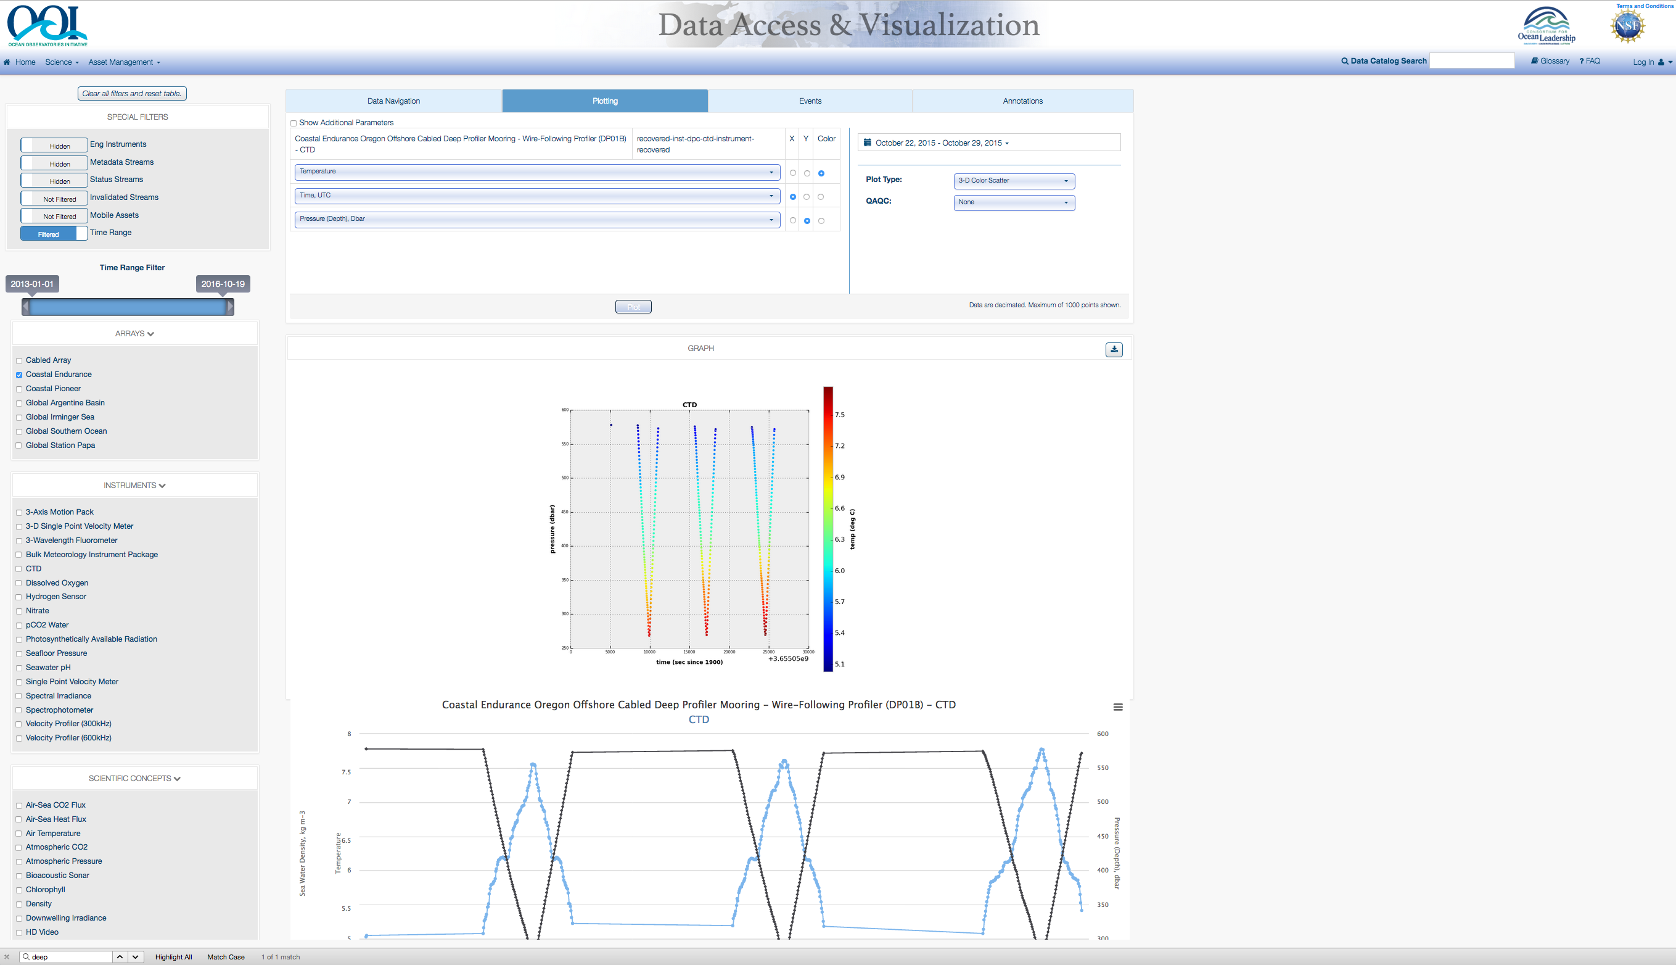
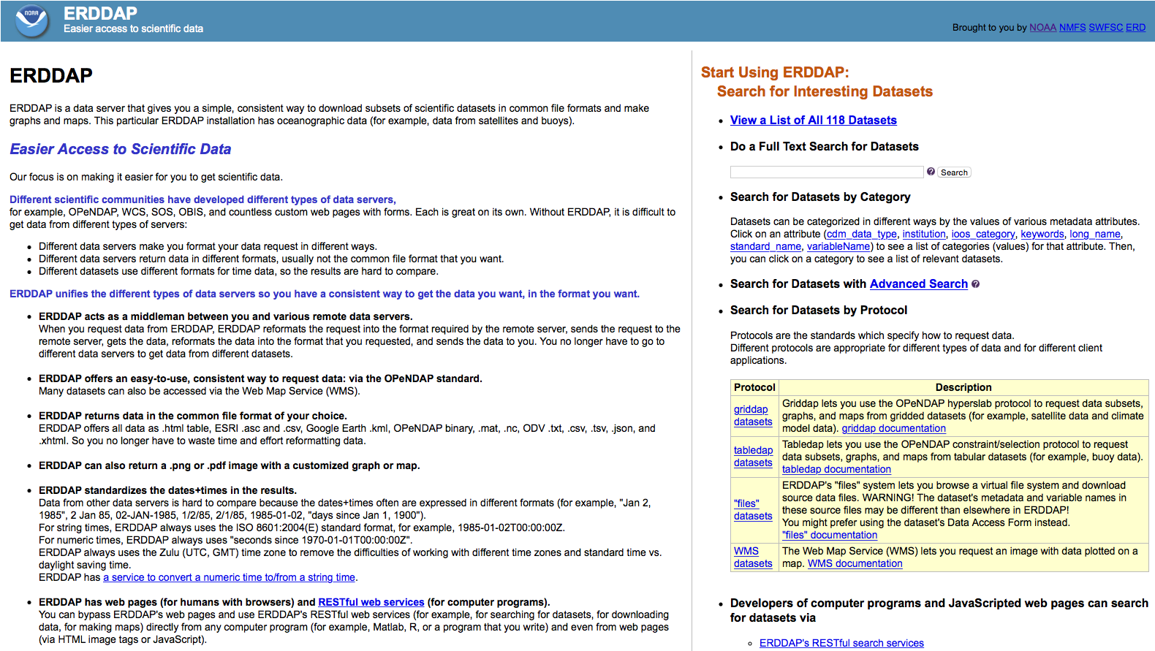
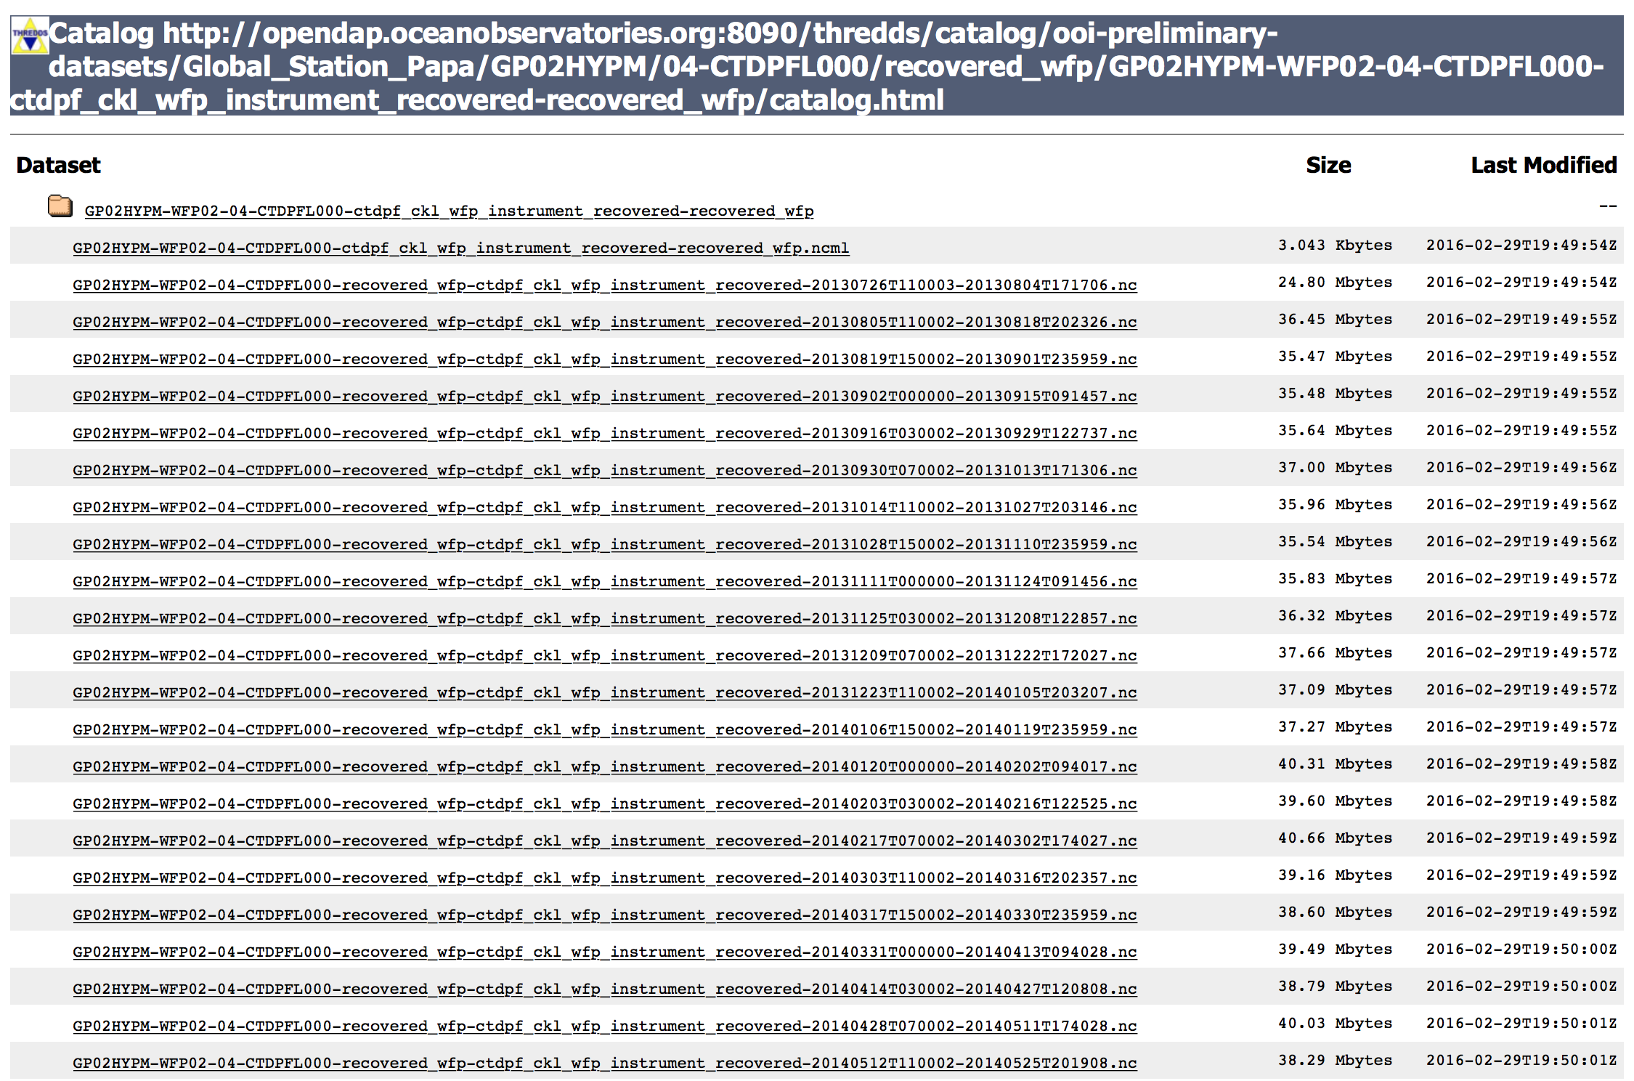
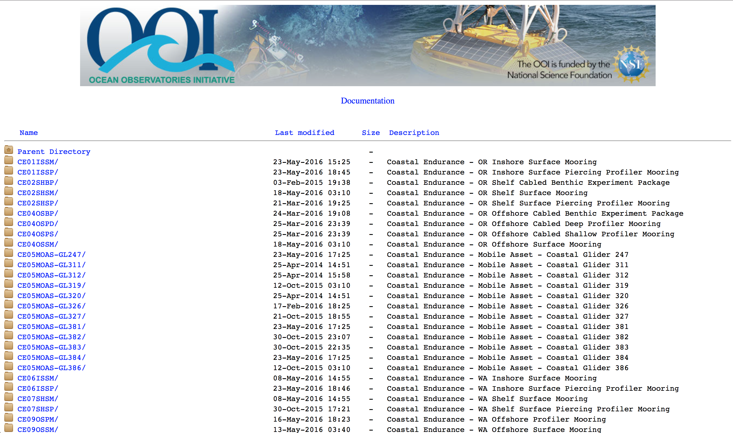
Integrated Software Stack
oceanobservatories.org
OOI Data Portal + M2M
Alfresco
(cruise and doc CM)
Raw data
ERDDAP
THREDDS
uFrame Service-Oriented Infrastructure
OOI Data
OOINet

Slide 5
Best Practices: IT Industry is Mature
Best industry best practices are proven (”Cookbook”)
Enterprise infrastructure, vendor-supported
Integrated data lifecycle management
Redundancy, fail-over, backup
Firewalls/VPN, segregation, 2-factor authentication
Authenticated RESTful APIs, SSL-based
Federated identity management
Agile methods
DTAP model, automation, continuous integration
Integrated monitoring, logging
Business continuity, system maintenance management
Etc.
Not always possible (different level of adoption)
Expensive: enterprise vs. commodity
Office hours vs. 24/7 support
Personnel with adequate background/experience in academic environment

Slide 6
Best Practices: Community Perception Matters
The life of the system administrator CI operator
I need root access to this development environment. Do not worry, I will be careful…
I need SSH access to production to grep into some log files…
Do we really need to use a VPN?
I can SSH into XSEDE. Why I cannot SSH into OOI servers?
I think I need more memory to run this application.
How much do you need?
How much is the maximum possible?
Community perception: The system is not open, there are too many road blocks, too many constraints
Need for ”CI best practices” accepted by academic community
Workforce: training on these practices
Engagements: what vs. how

Slide 7
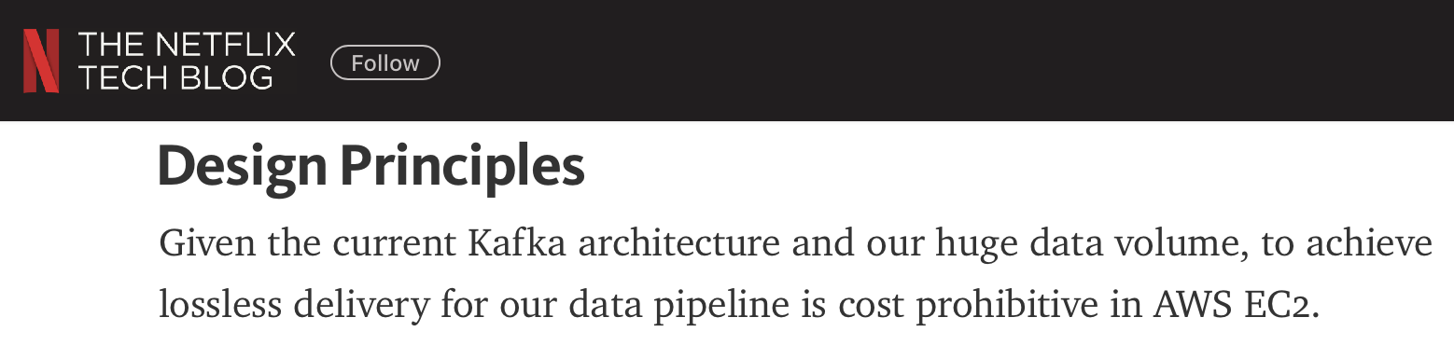
Role of Academic and Commercial Services
A (data) facility does not necessarily need Cloud/CI services by definition
Specific science mission; scope of work and budget
Beyond baseline services
Analytics; alternative data delivery methods (e.g., push mode); Content Distribution Networks
Hybrid models with academic clouds/CI
Not only compute/storage but research networks, services, expertise
Clouds provide flexible and robust abstractions
Suitable for global data delivery
However, cost is a concern when data rates increase

Slide 8
Shared CI Resource/Service Models
Users must download and process data locally
Requires powerful computing, storage, and networking
Limits impact and usability of data to those with access to such resources
NSF-ACI can support these use cases but remains largely disconnected from scientific facilities
Integrate facilities (e.g., OOI) with NSF-ACI in an automated manner
Leverage existing NSF-funded infrastructure to support processing of data and creation of new data products
Leverage existing high-speed interconnects (internet2)
Model 1: CI resources/services used as a utility (XSEDE, OSG, Chameleon, CloudLab, etc.)
Model 2: CI resources shared for building a ”bigger” CI. Synergies/win-win opportunities are possible but challenging

Slide 9
Beyond Data Delivery
Enable workflows that when triggered can seamlessly orchestrate the entire data-to-discovery pipeline
Provide distributed content-delivery networks (CDNs)
Manual query and processing of data
Users issue query for data to be transferred from large-scale scientific facilities and processed at NSF-ACI
Data-driven query and processing of data
Users register queries and workflows that automatically trigger computation when certain types of data are available or when certain results from previous queries are observed
Data-driven query, aggregation, and processing across multiple data-stores
Allow users to define and register complex queries to couple multiple sources of data, which can potentially be processed in different ACI facilities

Slide 10
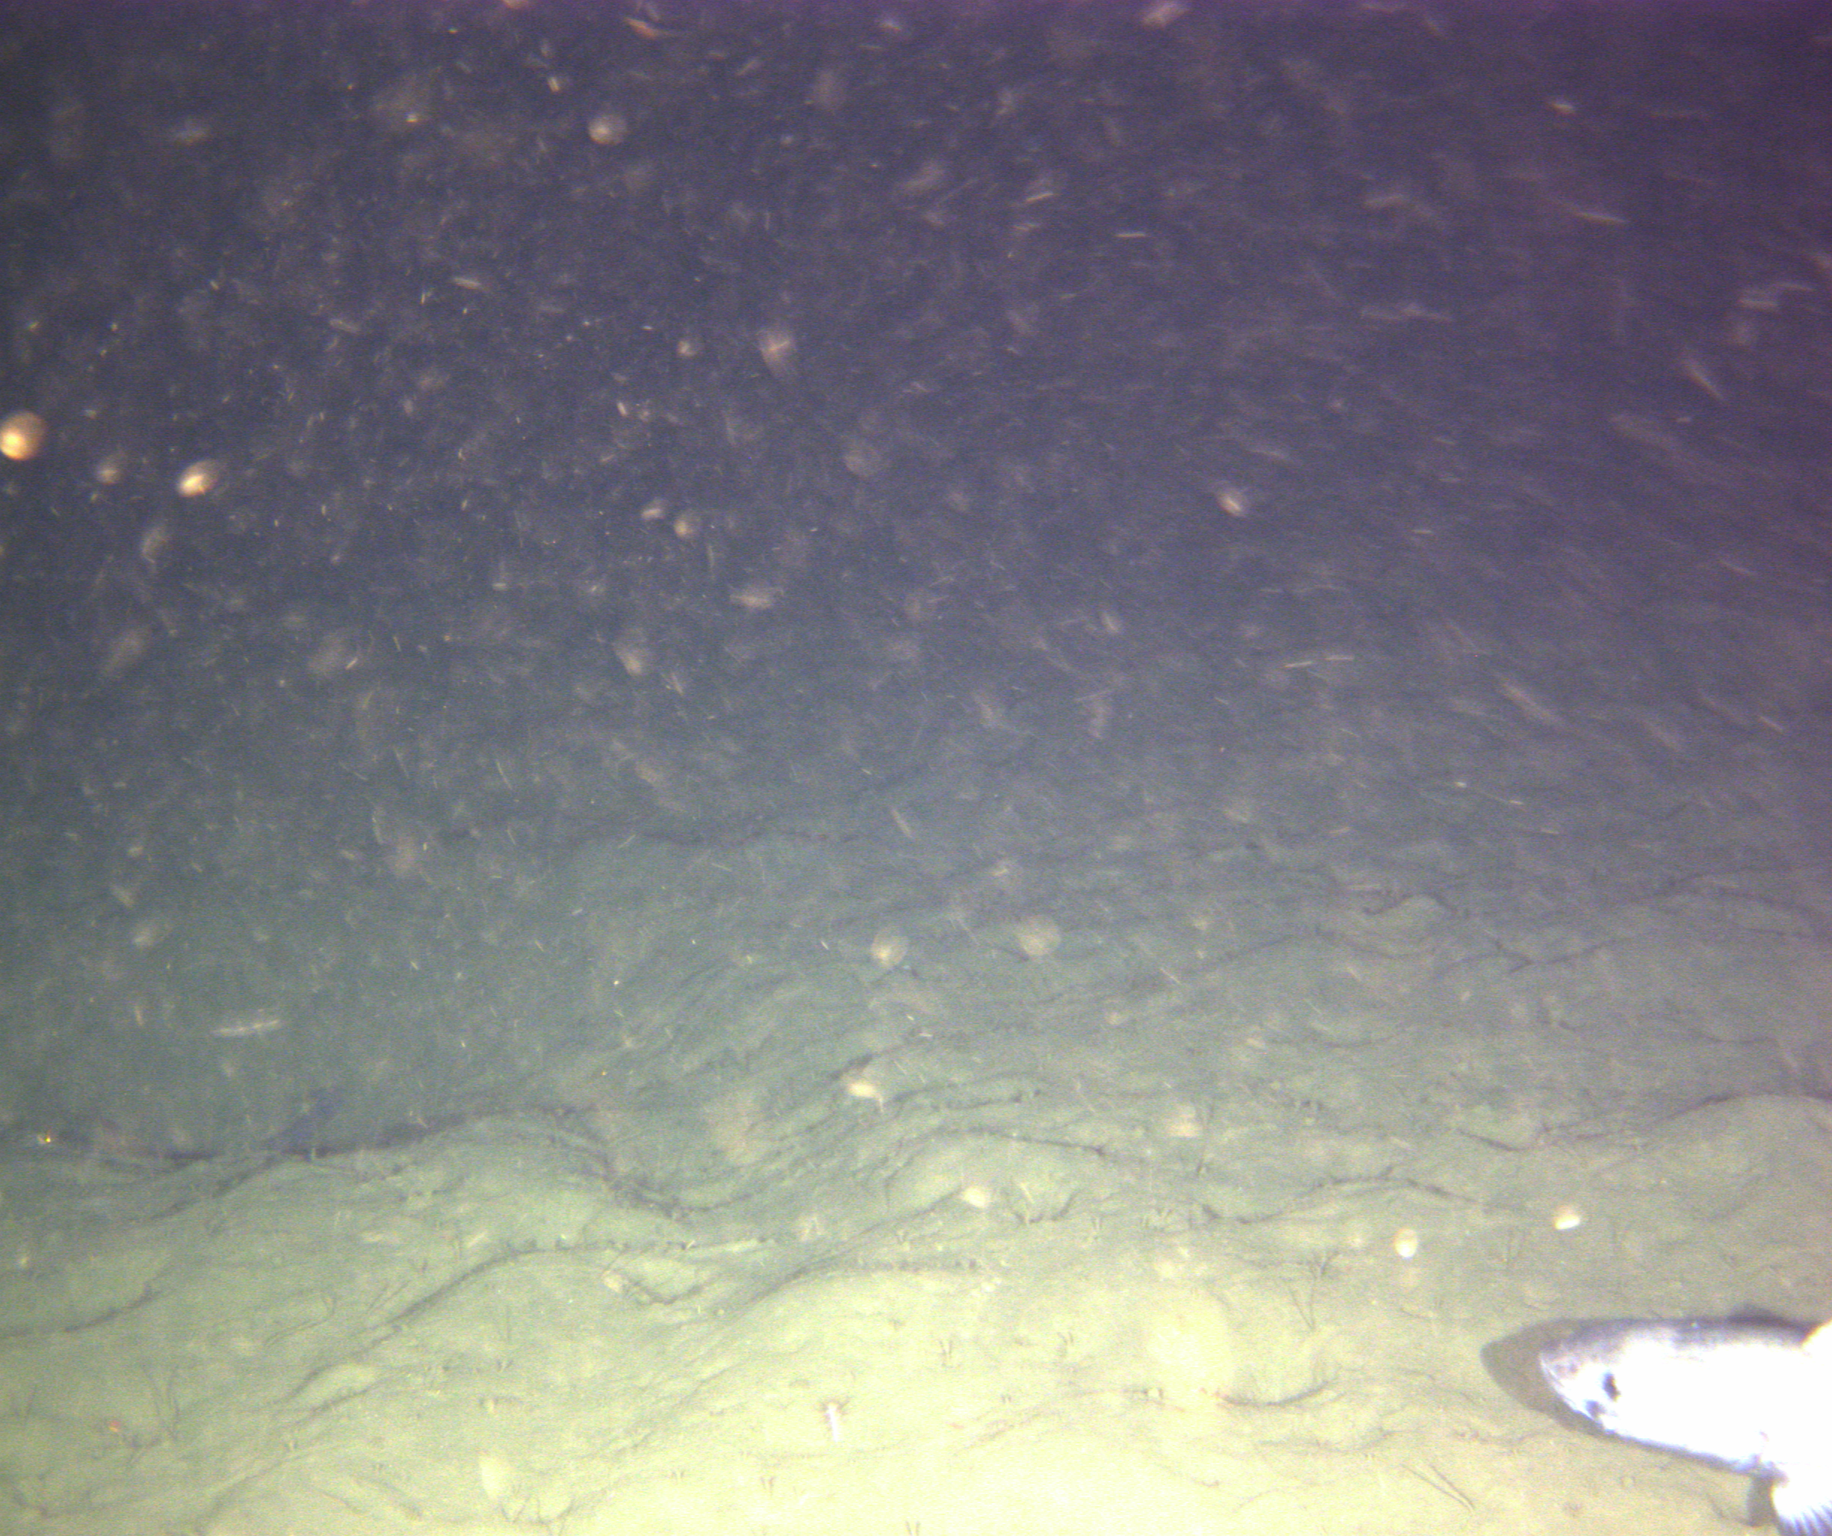
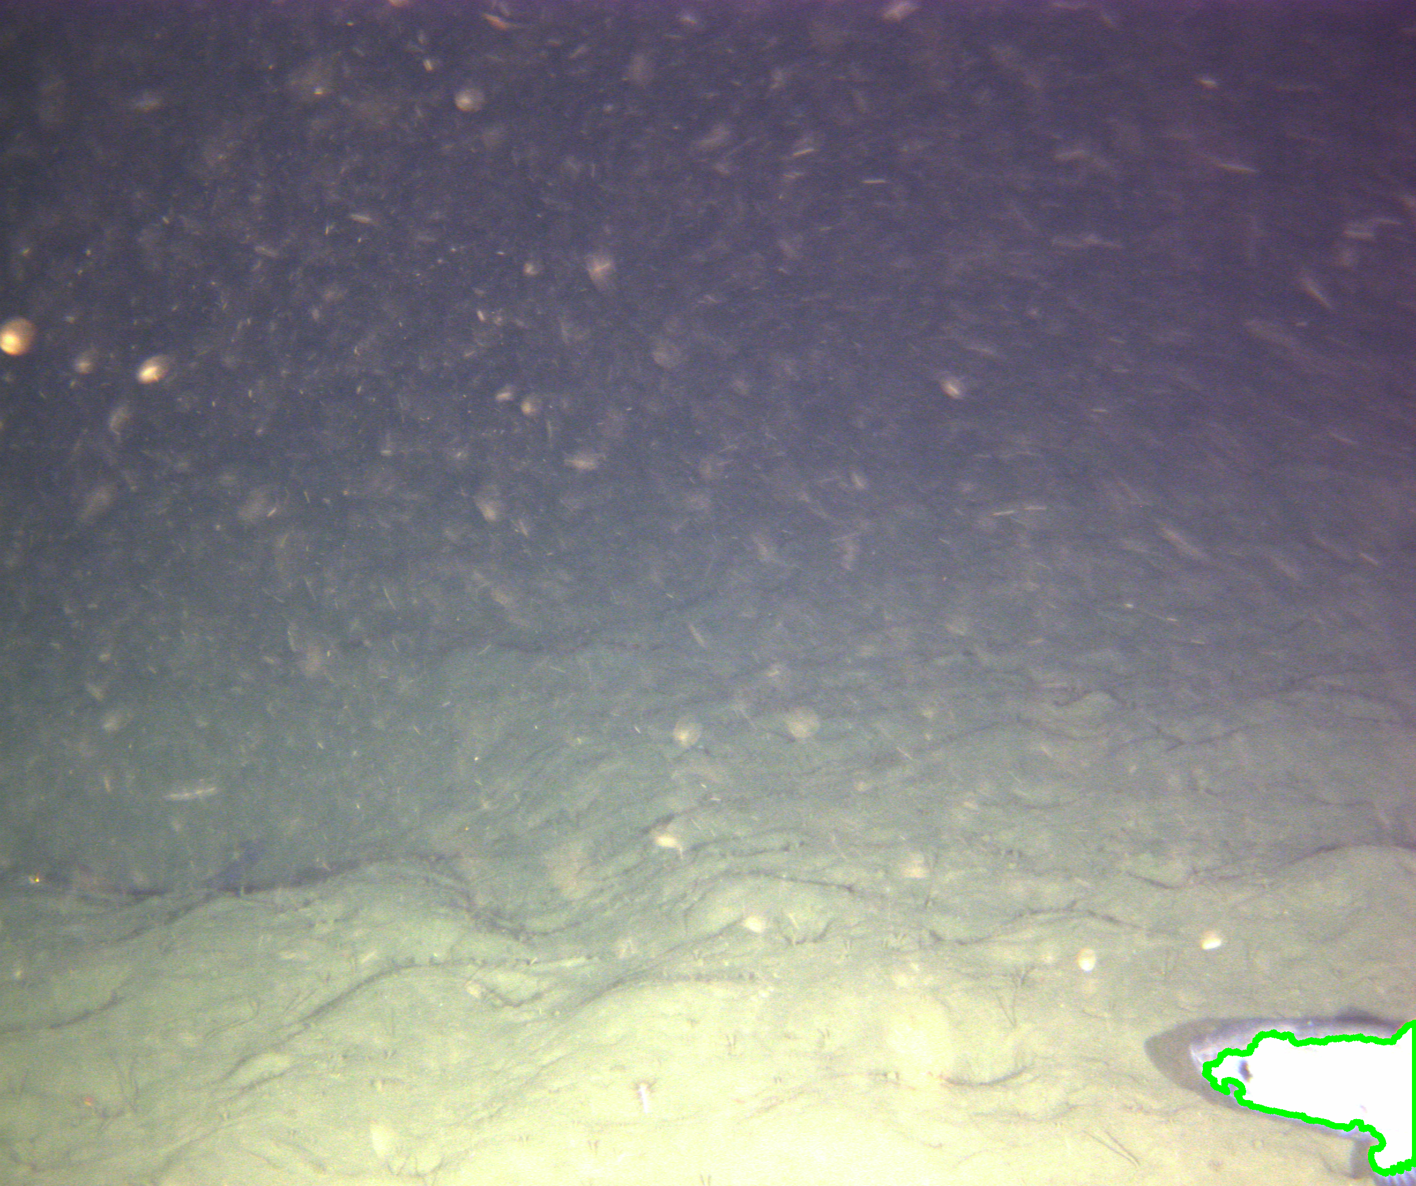
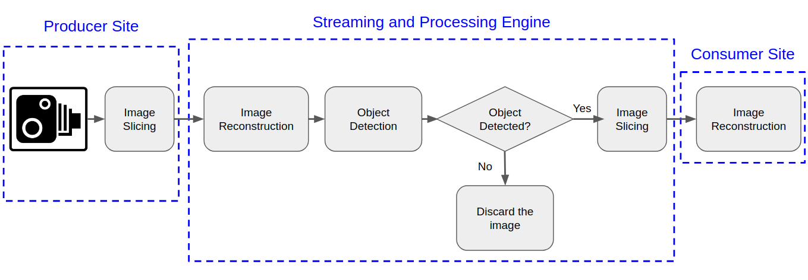
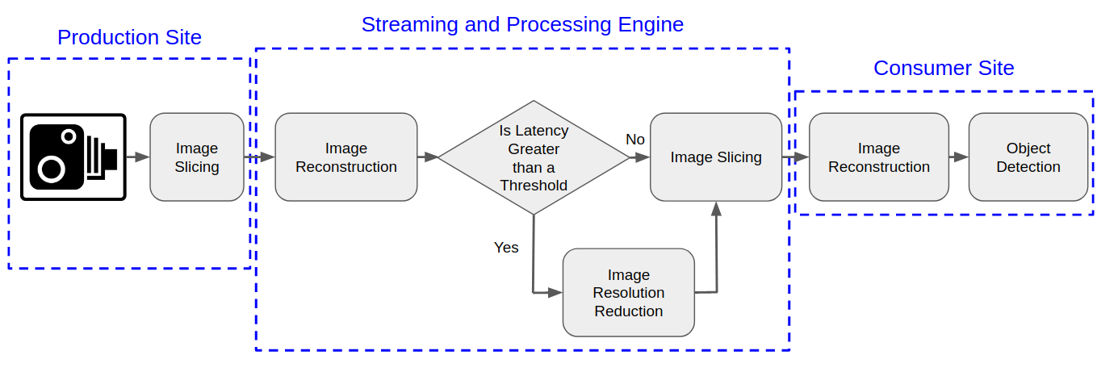
Digital Still Camera – Image Analysis on CI/Cloud
Architecture
Implementations

Slide 11
Continuity/robustness vs. forward-looking
Obsolescence plans
Upgrades, technology refresh (hardware, free and open-source software, etc.)
Evolving technologies
From messaging system X to Y
From relational to key-value store
Standard technologies/frameworks
Scalable building blocks (e.g., Cassandra, RabbitMQ, etc.)
Interoperable (guided by industry)
Large communities
Continuity while technology evolves?
Innovative technologies and solutions - Integration or CI upgrade
Side effort (facilities funded for specific scope of work)
Integration best practices?

Slide 12



Thank You!
irodero@rutgers.edu
facebook.com/rutgersRDI2
@RDI2_rutgers
rdi2.rutgers.edu

